Slide 1
Mrs. Lombardo’s
Things Fall Apart
English Paper

Slide 2
Stuff for your class
Yea!……Your class has its own web blog!!!!!
www.lombardoenglish.weebly.com

Slide 3
Evaluating your resource
RADCAB
Why?
Peer Review

Slide 4
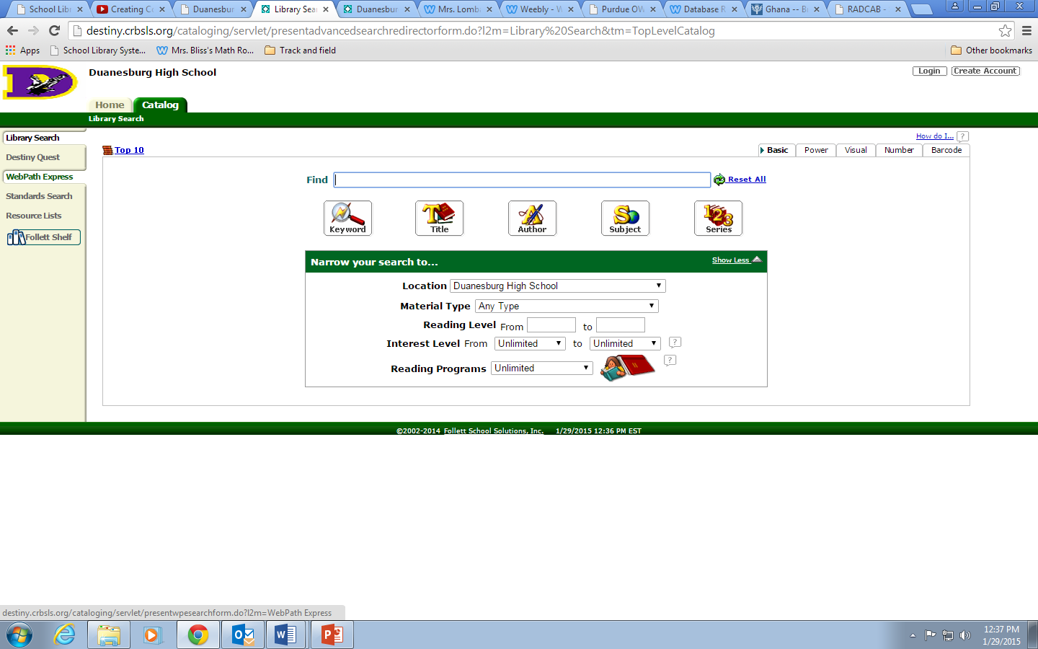
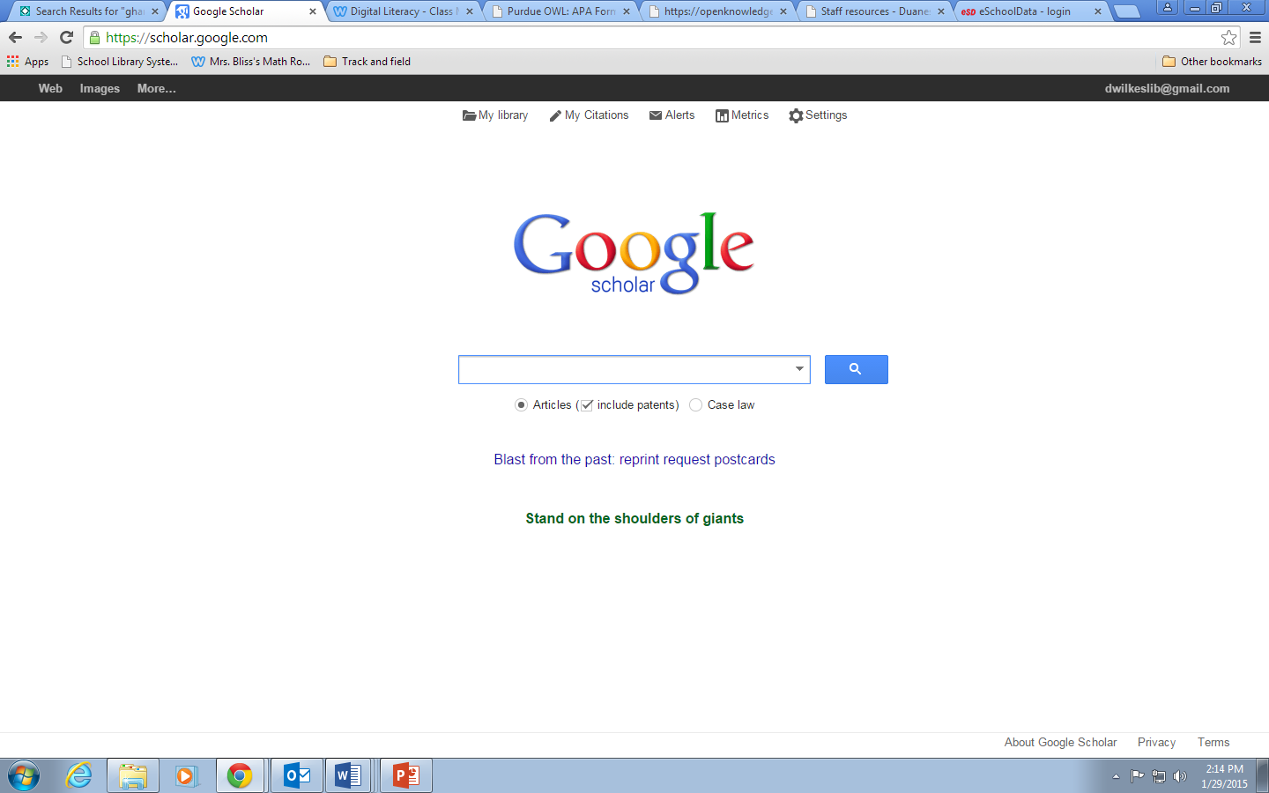
Resources!
Keywords/Search Terms
Book and eBooks , Electronic Sources

Slide 5
Don’t “borrow” other peoples stuff w/o permission…..
You will need to Cite Your Sources! Purdue OWL

Slide 6
Notes???? Front Side
Number from “References” page
Country & Sub Topic
Resource #
Ghana - Culture
Color Coding

Slide 7
Notes Back Side
Your name here!

